Slide 1

Pundra University of Science & Technology
Web Based Auction Management System
Course Title: Thesis/Project Work
Course Code: CSE 499(B)
Presented By: | Supervised By:
Name: Md Nahid Hasan | Name: Md. Easir Arafat
ID: 01821106007 | Designation: Lecturer
Batch: 18th | Department of CSE
Department of CSE

Slide 2
Contents
Introduction
Motivation
Objectives
System Design
Data Flow Diagram
E-R Diagram
Use Case Diagram
UML Class Diagram
System Implementation
Bid Assistant
Future Work
Conclusion

Slide 3
Introduction
The rise of online shopping has transformed traditional auction methods, making them more accessible and convenient. Our Web-Based Auction Management System is designed to offer an easy, safe, and user-friendly platform for online auctions. With automated tools and real-time updates, the system makes the auction process smoother for both buyers and sellers, ensuring fairness and transparency.

Slide 4
Motivation
This project is inspired by the need for online auction platforms that can support more users while staying simple and secure. Traditional auctions often face problems like being slow, missing real-time updates, and not being fully safe. Our goal is to create a system that fixes these issues, builds trust, keeps users interested, and makes sure auctions run smoothly, even with more transactions.

Slide 5
Objectives
Efficiency: Automate and streamline the auction process.
Scalability: Support a high volume of transactions and bids.
Transparency: Ensure fairness with Dynamic Auction End Times.
Auction Bidding Assistance: Users can set their maximum bid, and the system automatically places bids for them, starting from the lowest price and increasing until the limit is reached. This feature helps users stay competitive without constantly monitoring the auction.
User Engagement: Provide Real-Time Notifications to keep users updated.
Security: Protect user data and prevent fraud.

Slide 6

Data Flow Diagram Level 0

Slide 7
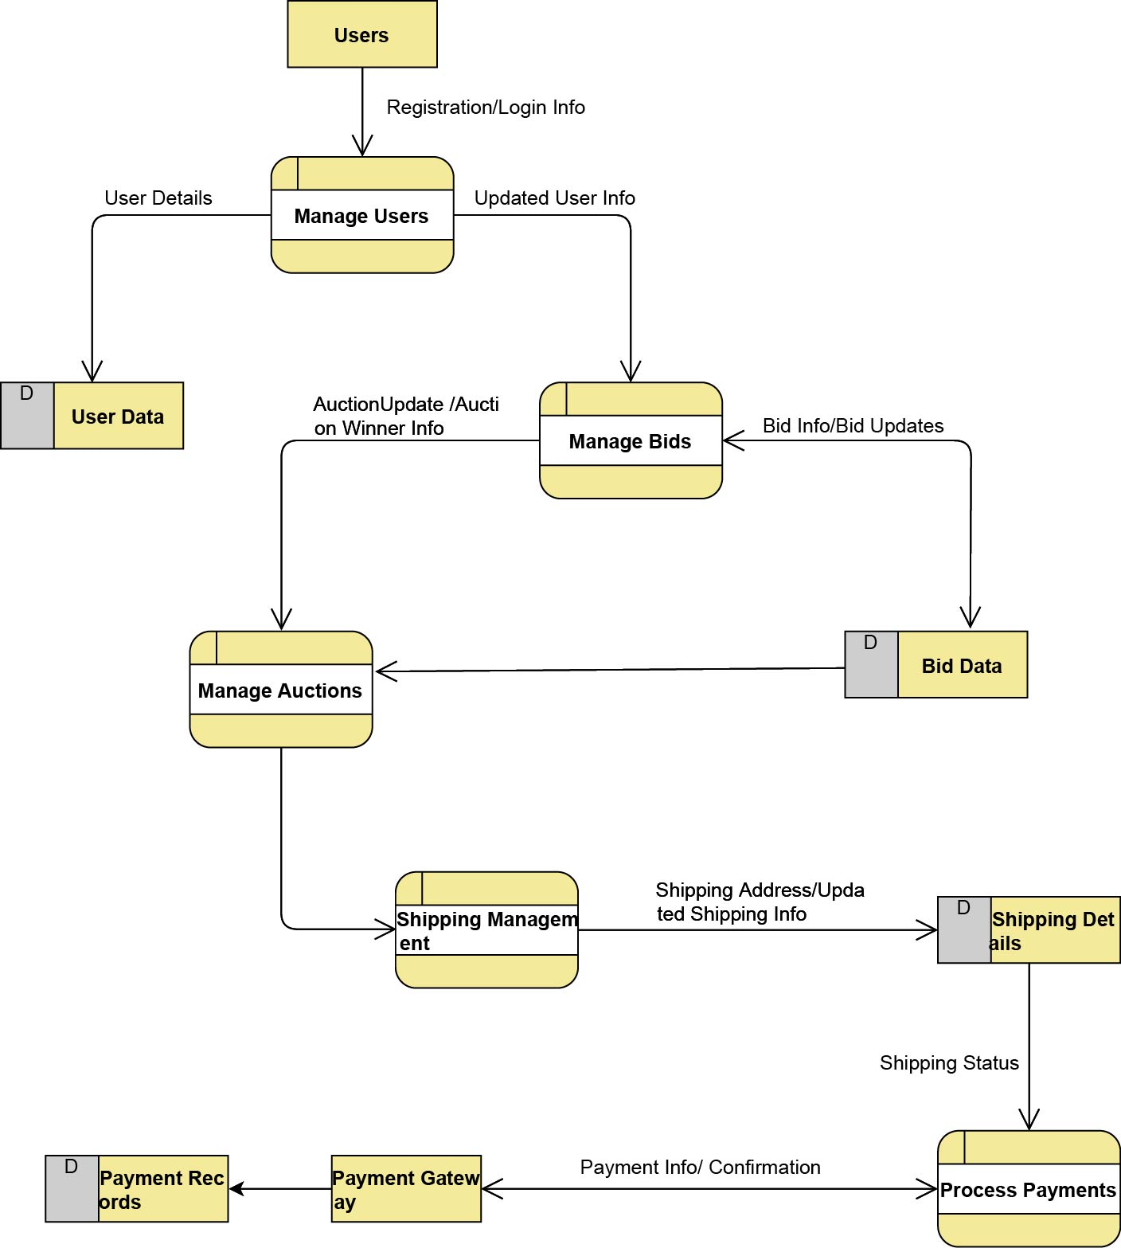
Data Flow Diagram Level 1

Slide 8
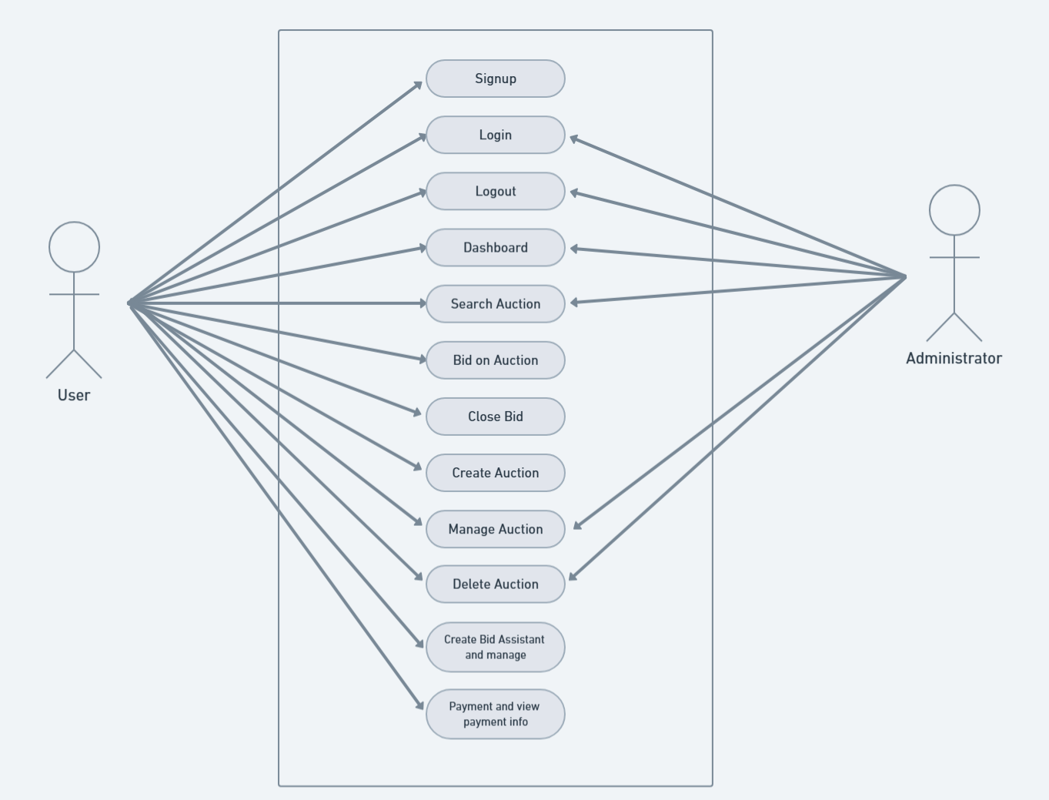
Use Case Diagram

Slide 9
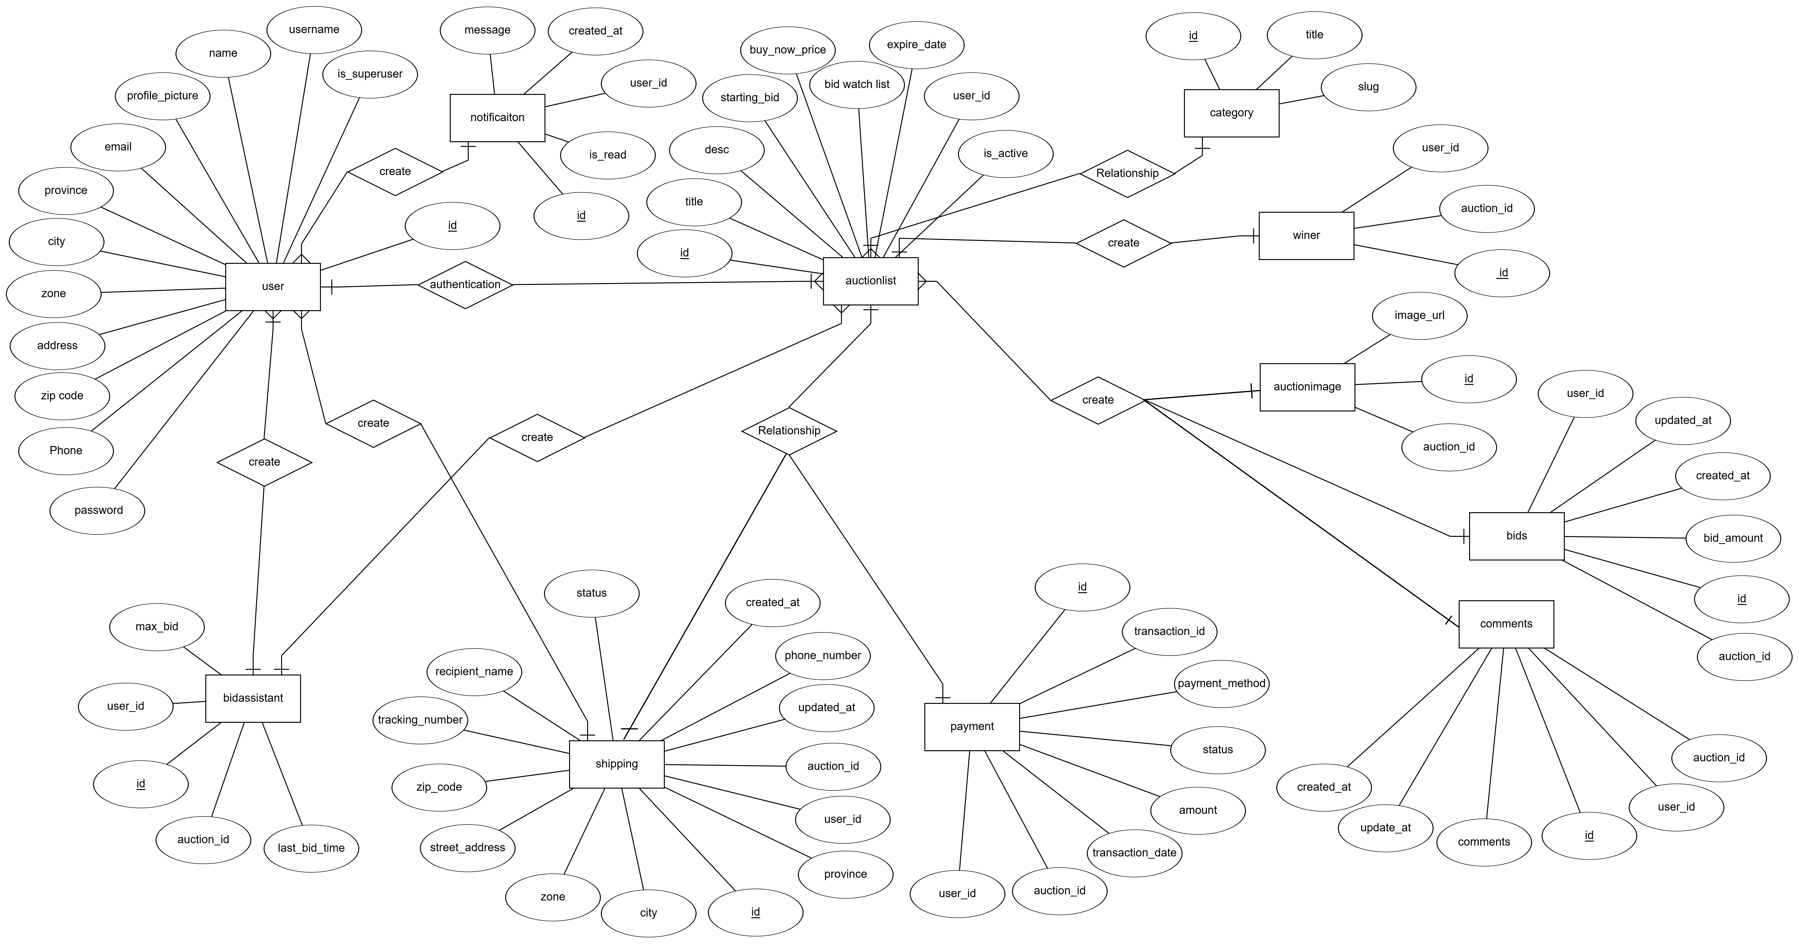
E-R Diagram

Slide 10
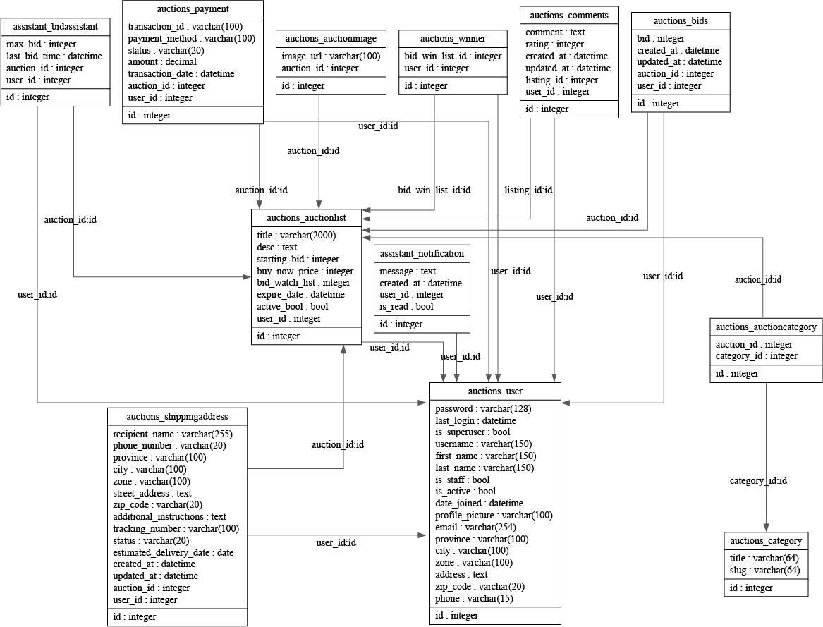
UML Class Diagram

Slide 11
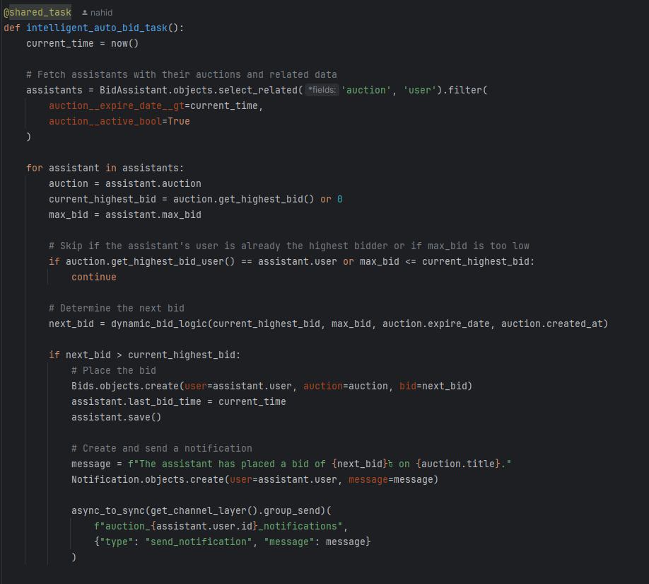
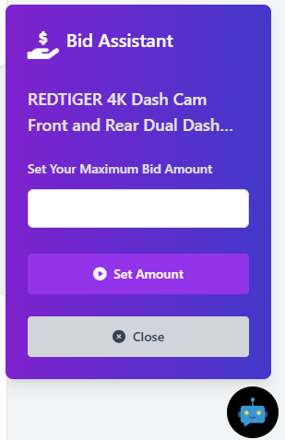
Bid Assistant

Slide 12
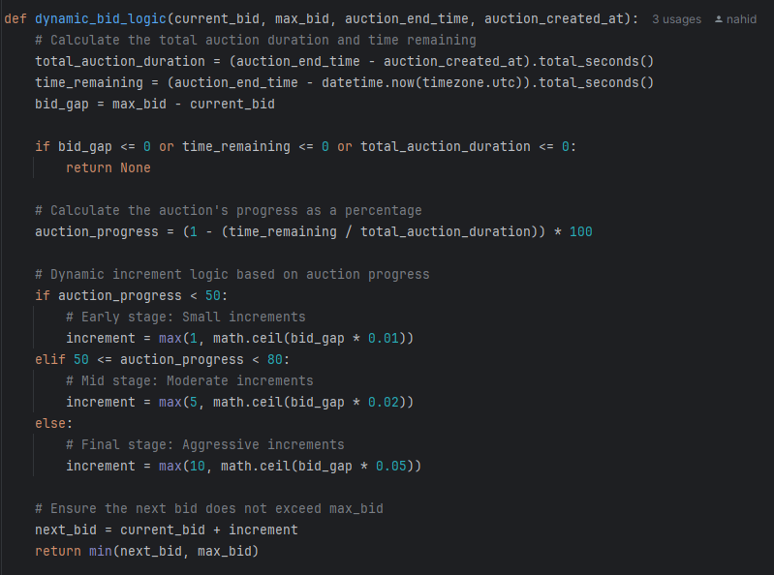
Bid Assistant

Slide 13






System Implementation
Technologies Used:
Frontend: HTML, CSS, Tailwind CSS, JavaScript
Backend: Python, Django
Database: PostgreSQL
Payment Gateway: SSLCOMMERZ
Payment Gateway: SSLCOMMERZ
Frontend: HTML, CSS, Tailwind, JavaScript
Backend: Python, Django
Database: PostgreSQL

Slide 14
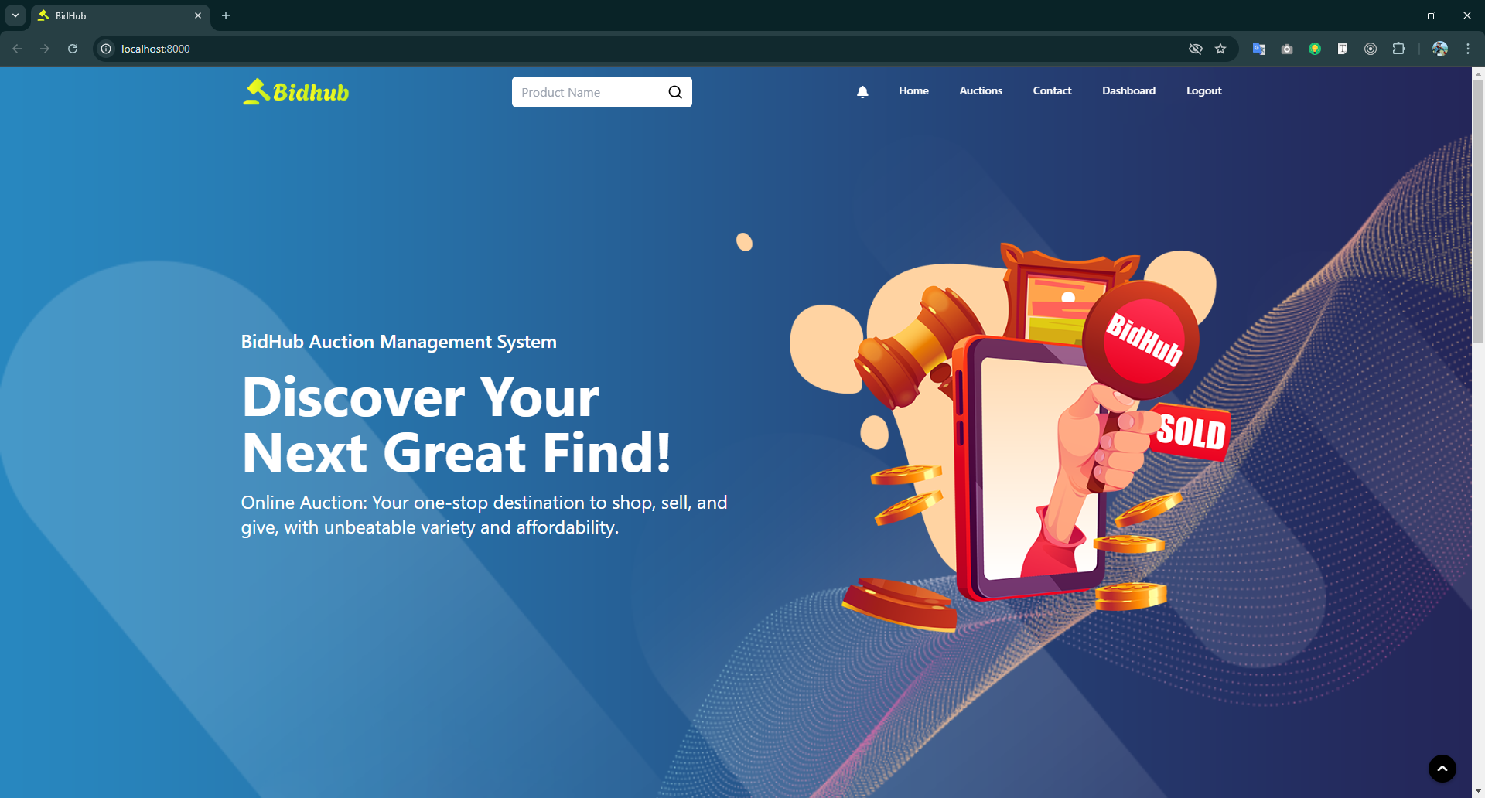
Home Page

Slide 15
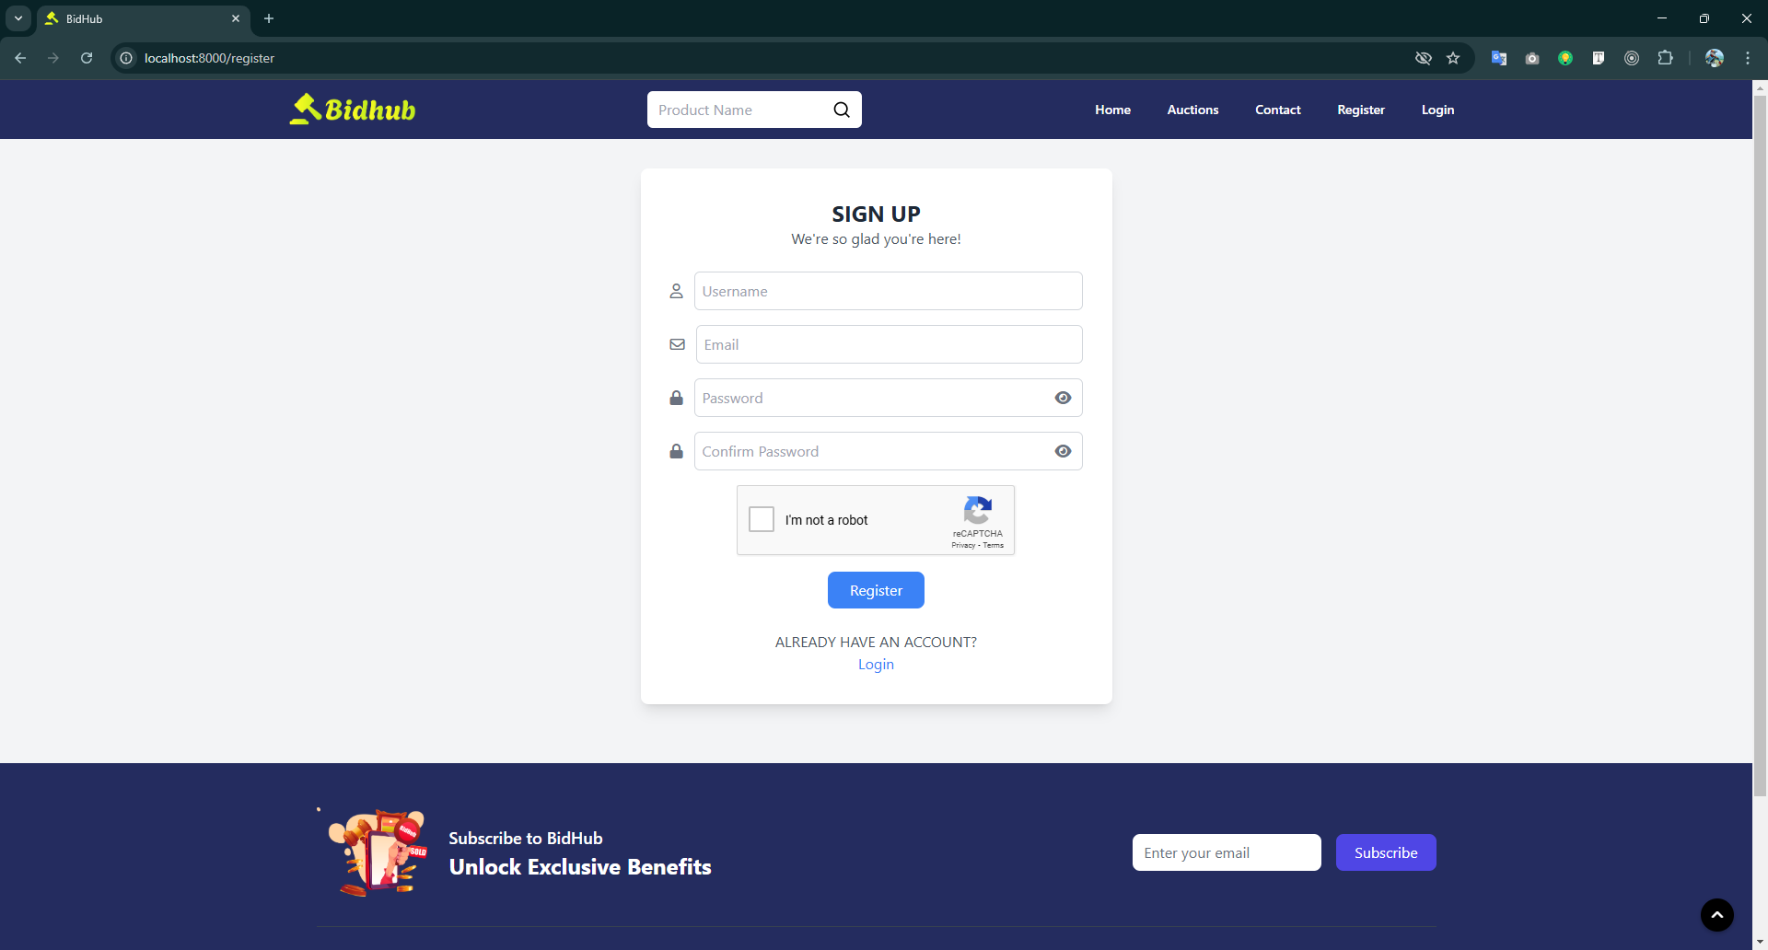
Signup Page

Slide 16
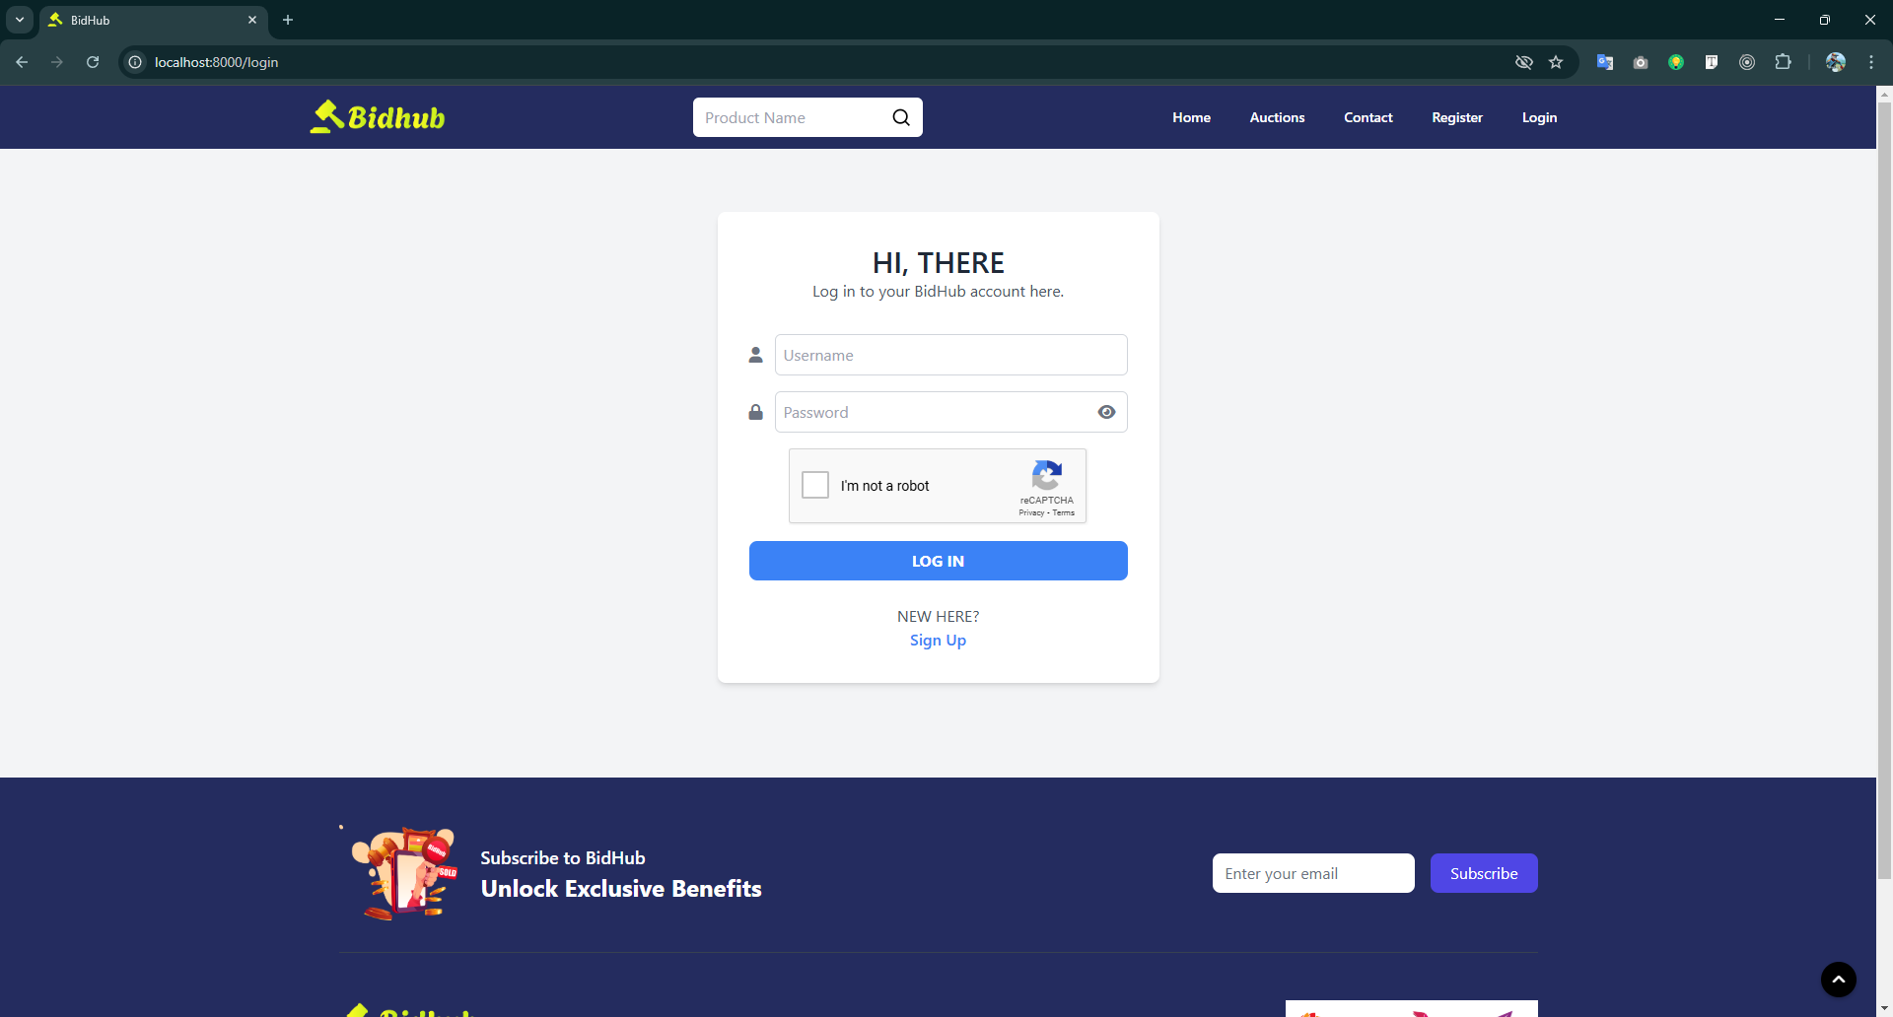
Login Page

Slide 17
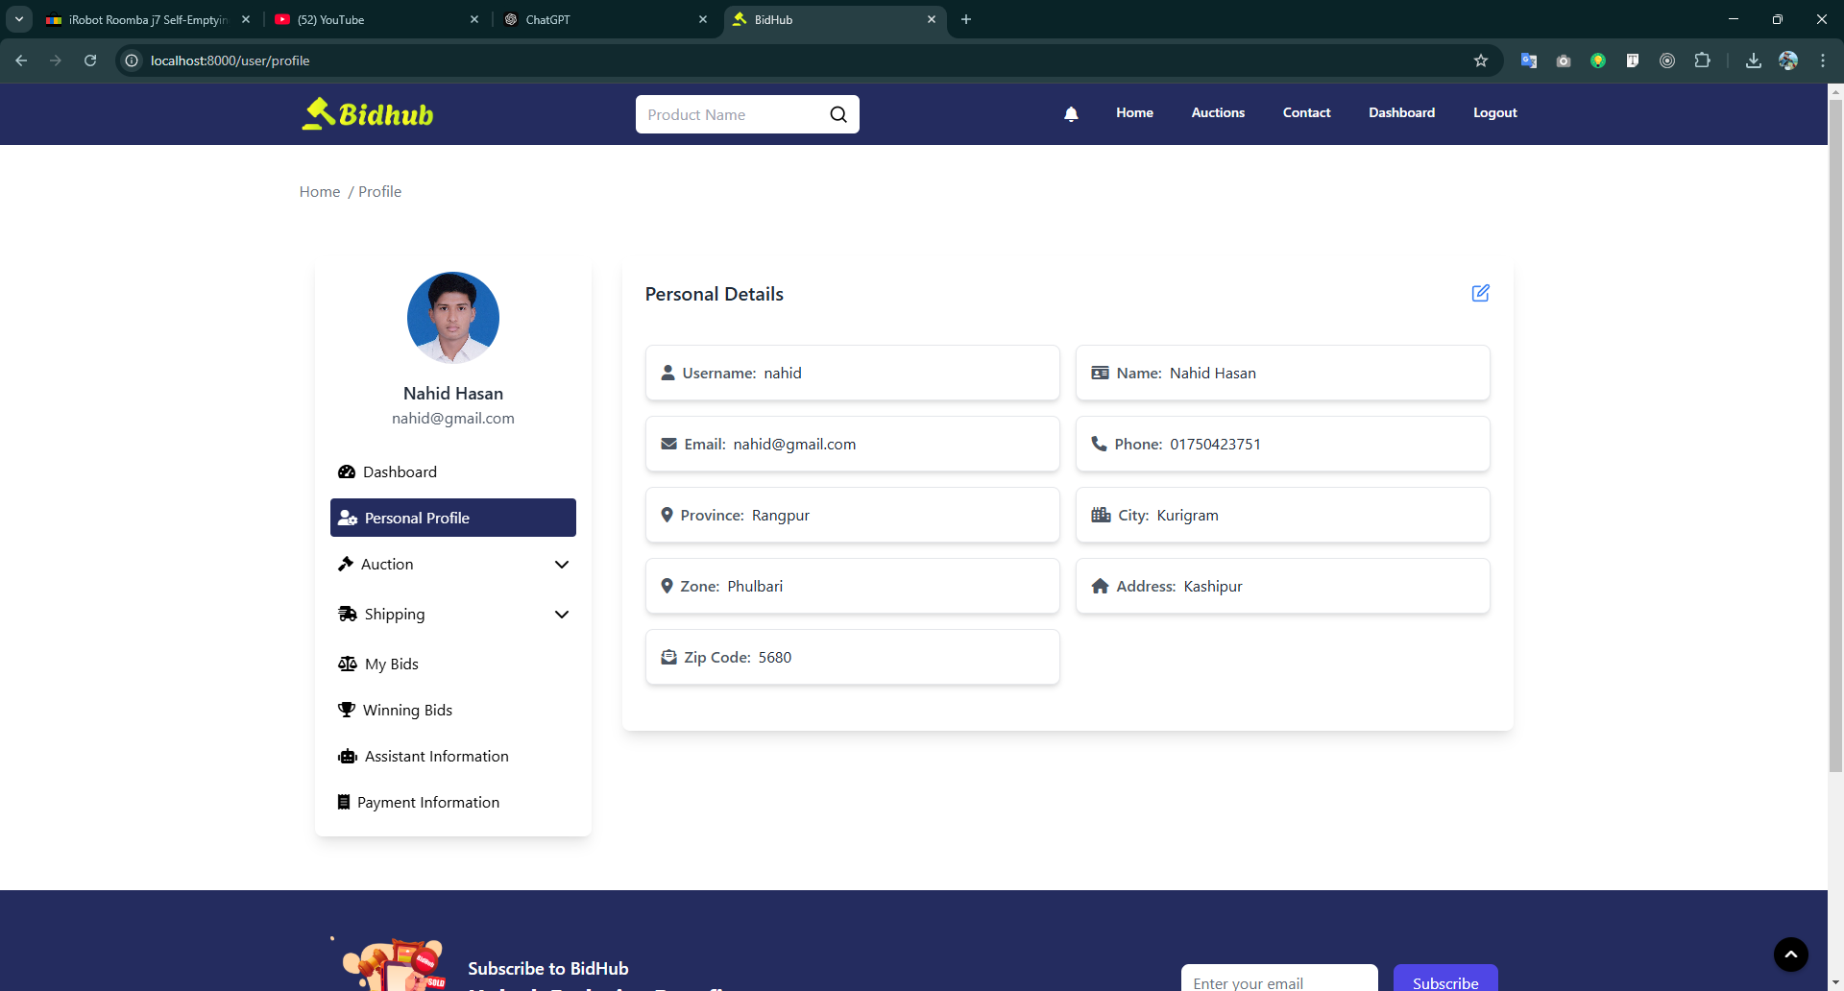
Profile Page

Slide 18
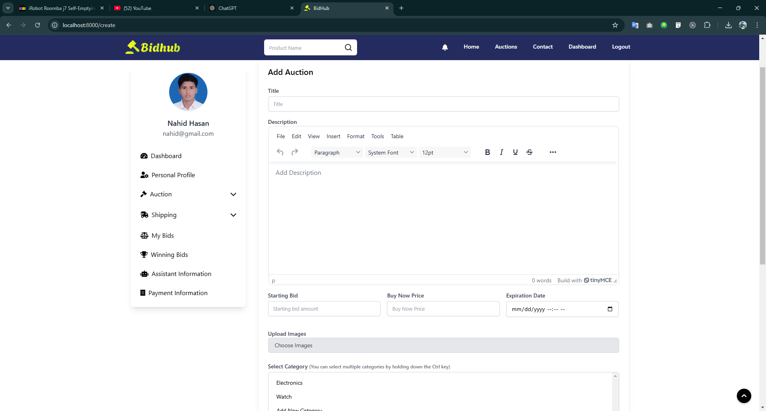
Add Auction Page

Slide 19
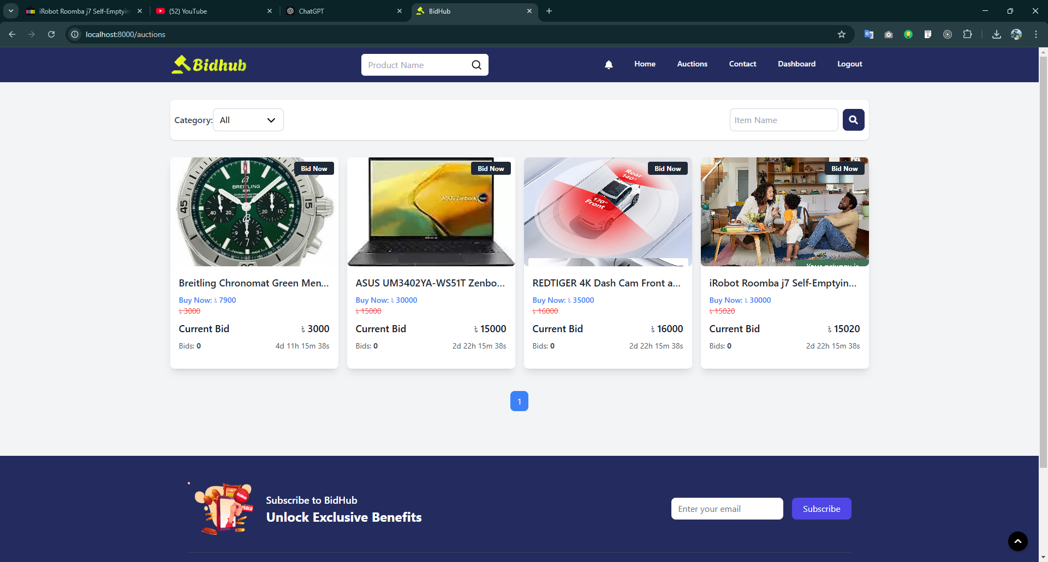
Auction List Page

Slide 20
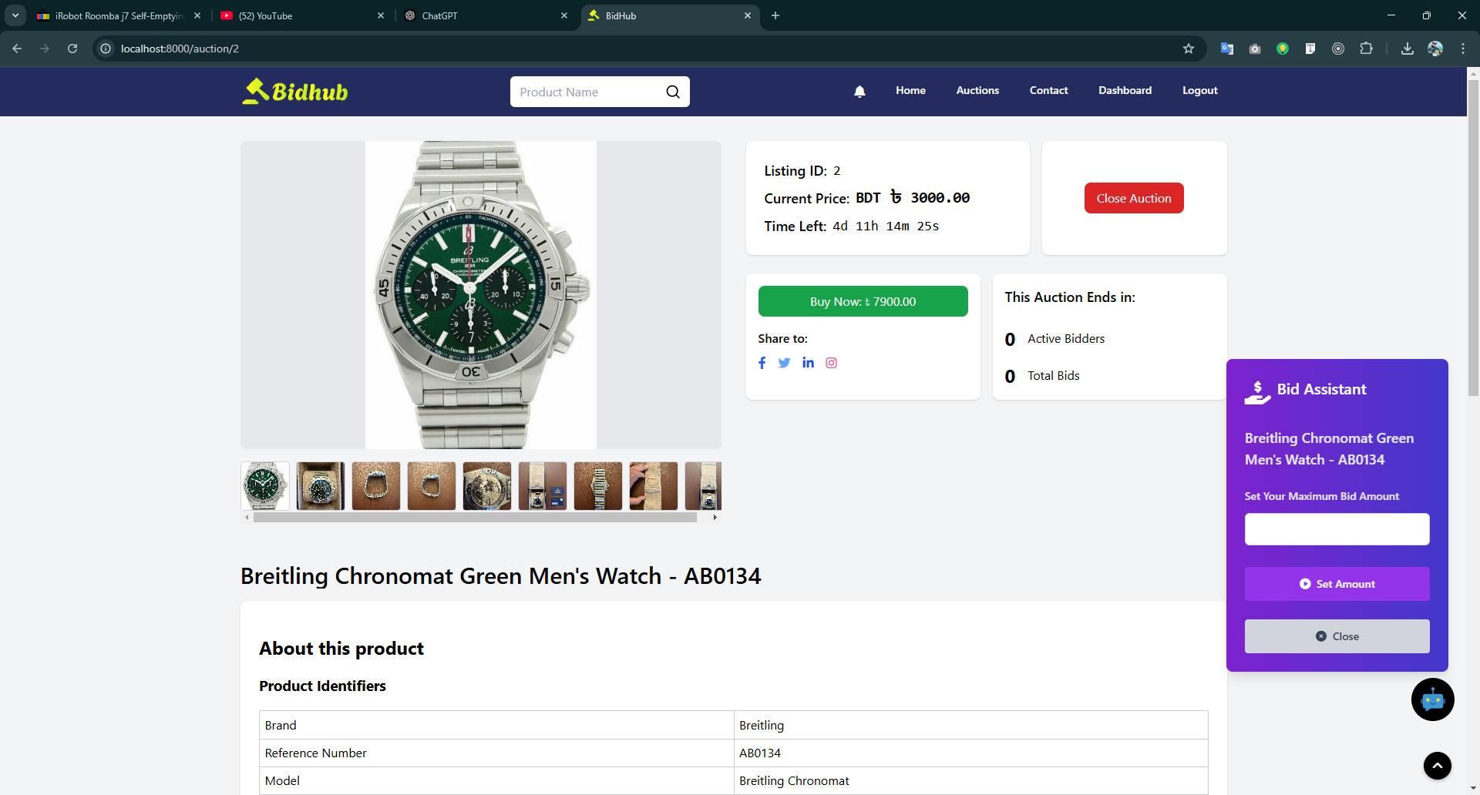
Auction Details Page

Slide 21
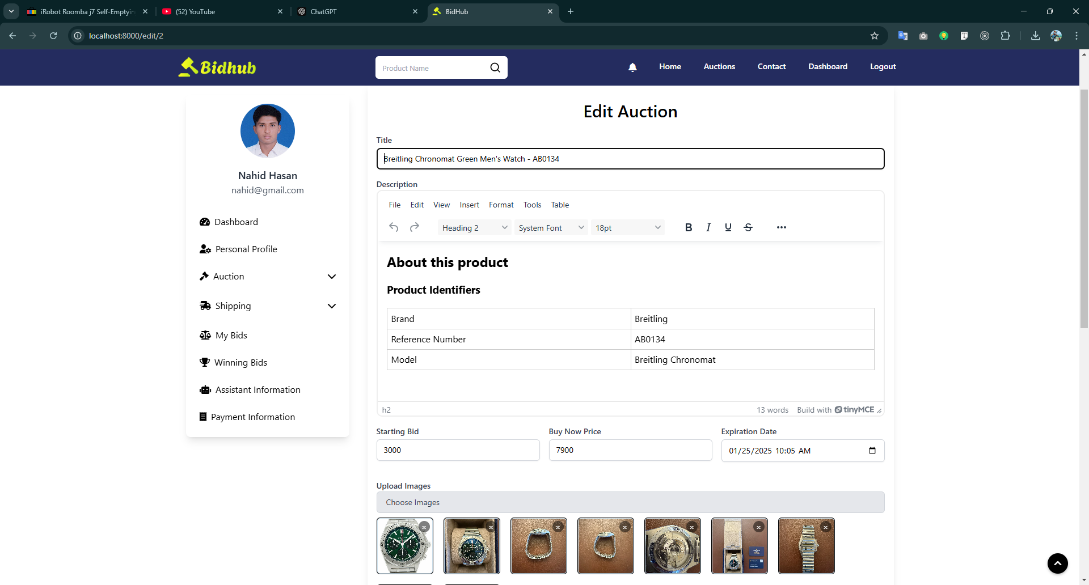
Auction Edit Page

Slide 22
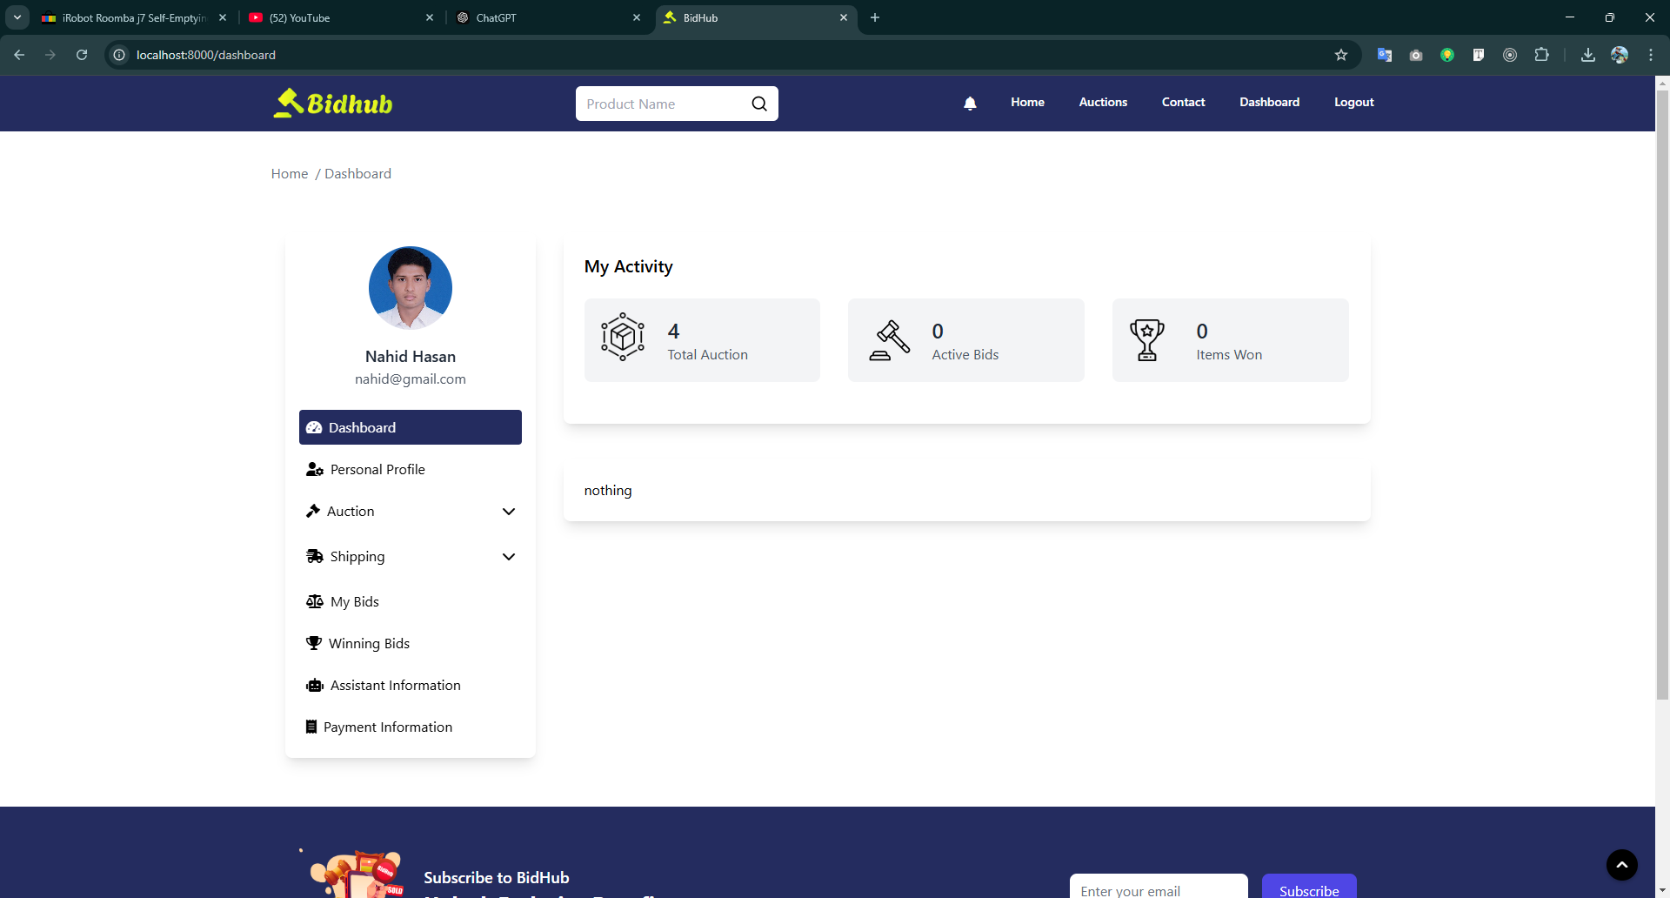
Dashboard Page

Slide 23
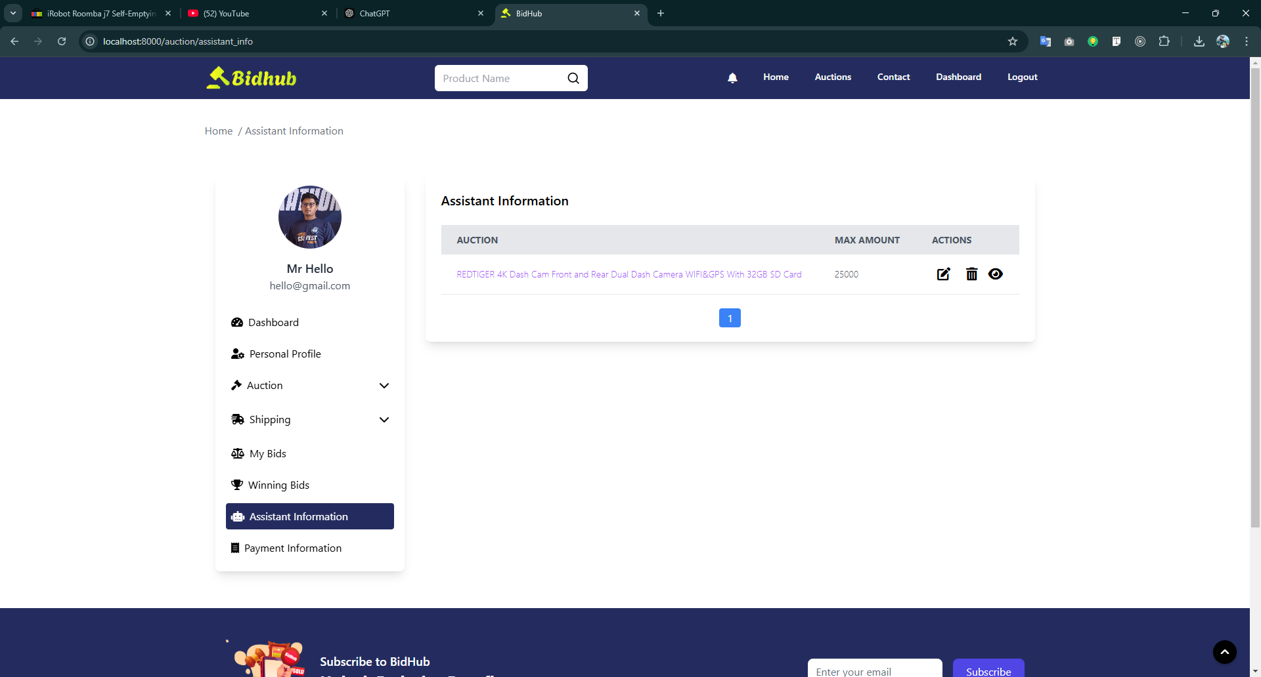
Assistant Information Page

Slide 24
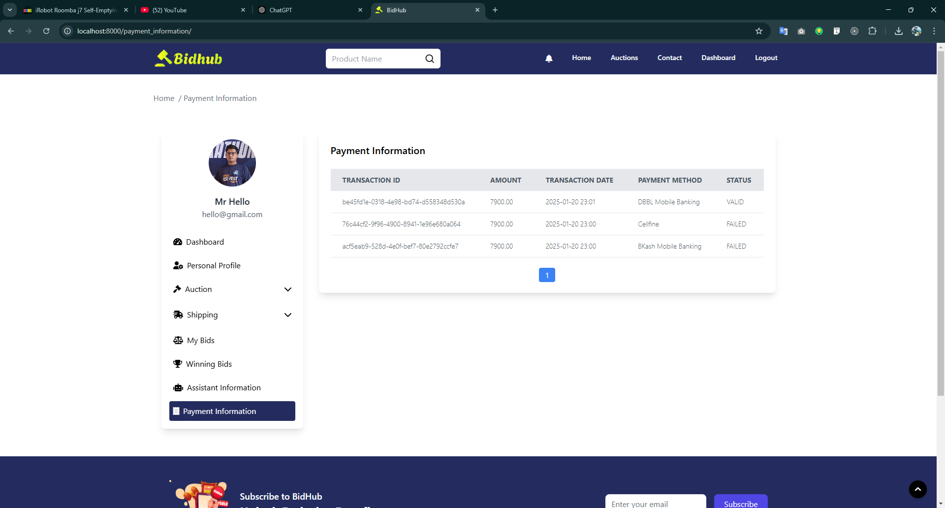
Payment Information Page

Slide 25
Future Work
Enhanced Bid Assistant: Smarter, adaptive bidding strategies.
Shipping Improvements: Dynamic cost calculation and tracking.
Android App: Core features on mobile for better accessibility.

Slide 26
Conclusion
Our Web-Based Auction Management System solves the problems of efficiency, scalability, transparency, and security in online auctions. With features like flexible end times, real-time notifications, and automated bidding, the platform improves user experience and keeps auctions fair and smooth.

Slide 27
Thank You

